Slide 1
NGSE Governance & Community
07.

Slide 2
Prioritization Governance for markets
Markets submit ideas, proposals and requests for changes. enhancements in NGSE providing descriptions, benefit, time for realization and requirements
Request Repository
COE groups similar ideas together into use cases, epics or/ and user stories, sequences priorities of impact/value, identifies funding (where needed) and submits changes for assessment & governance
NGSE International in its commitment to enhance the capability of the tool in supporting sales reps' day-to-day workflows will set up a governance on the prioritization of the enhancements and their execution for a global roll out
Assess & Prioritize
ZTD provides work estimates based on priority for the enhancements and classifies these as major or minor request.
Evaluate Effort
Requests are reviewed/groomed, approved, and submitted for development
Governance
Meeting
Approved epics/ user stories are delivered by the product team in an agile mode through collaboration tools like Jira, Github
Development
Developers build the changes in test environment
Weekly Review
Test
COE tests and approves changes
Release
Final changes are scheduled for release to production

Slide 3
Change Actors in the Governance committee
Submit a Change Request
Assess and Prioritize
Evaluate effort
Govern & Review
Develop approved changes
Test
Release and Deploy
W
W
M
W
M
W
Owner | Market NGSE Champions |  | COE Lead– Rich |  | ZTD NGSE Technical Team |  | Governance Leads – Rich & Damien |  | ZTD NGSE Technical Team |  | COE |  | ZTD NGSE Technical Team
Others | COE |  | COE– Dan, Contract Bus Analyst |  | - |  | COE, ZTD |  | - |  | Market Requestor |  | -
Evaluation | - |  | Is there sufficient business value? Is it sufficiently global? |  | How much effort is required? |  | Should the request be implemented and what is the sequence? |  | - |  | Is the enhancement working as expected? |  | When should the changes be released?
Decisions | - |  | Approves the request for governance review and assigns priorities |  | Classifies requests as major or minor* |  | Provides approval for development and assigns timeline |  | - |  | Approves the testing results |  | Determines the timing for production release
W
M
Weekly Monthly

Slide 4
NGSE International Business Prioritization Framework
“When everything is a priority, nothing is a priority”
Link to current Enhancement Backlog
Determining Impact (one or more element is true)
High
Benefits many markets (5+)
Has a defined revenue estimate
Aligns with a specific International objective/strategy
Impacts compliance in market(s)
Medium
Benefits a few markets (1 - 5)
Originates from a field colleague idea
No revenue impact but does offer time savings
Low
Benefits just 1 market
No specific revenue or time savings benefit estimated
Estimating Difficulty (prior to technical assessment)
Easy
Change directly within the NGSE application/page
Moderate
Involves new or changed data from supporting platforms
Difficult
Requires new interface or work across ZTD teams

Slide 5
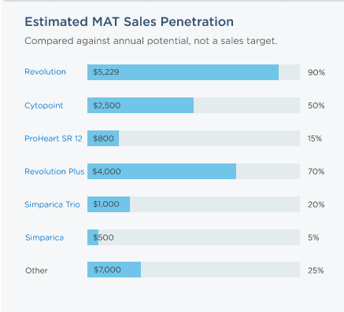
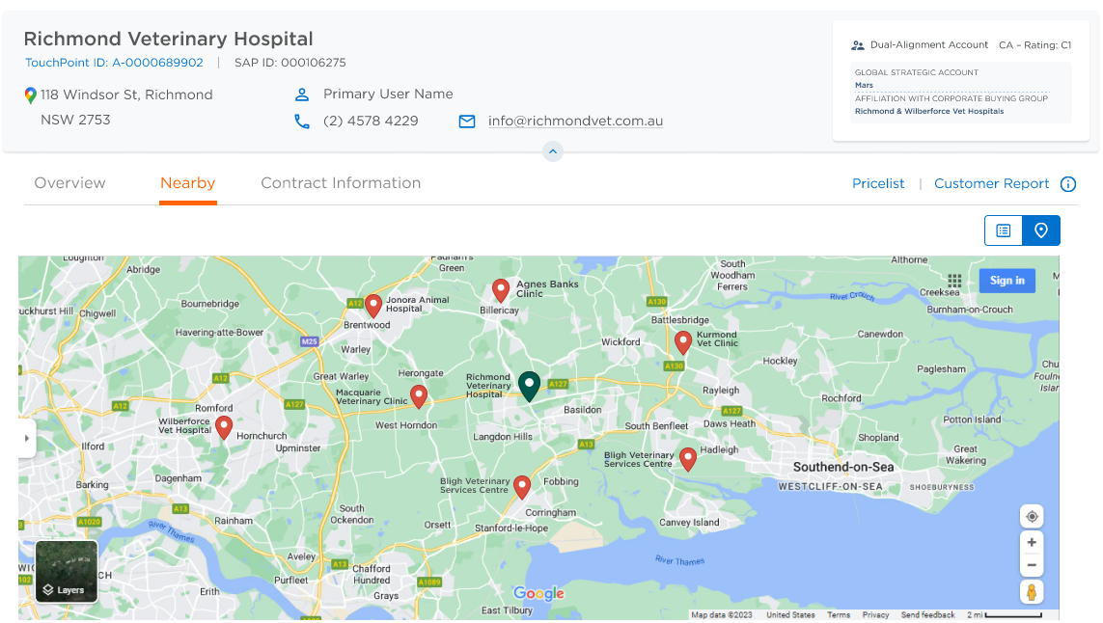
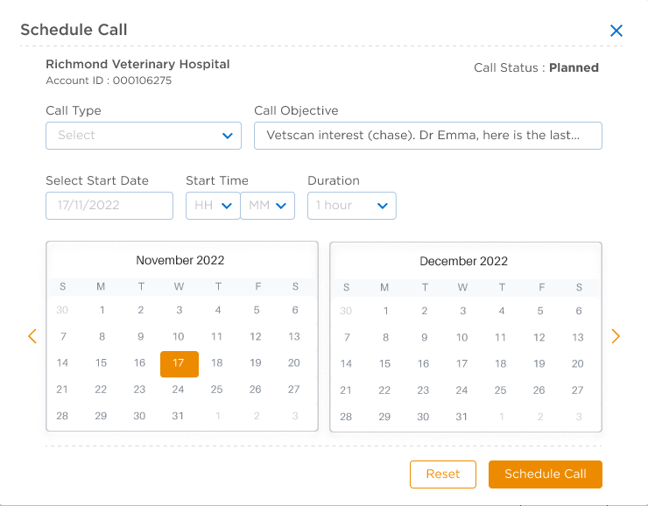
NGSE is committed to continuous improvements:
Leveraging Potential
Schedule calls from NGSE
Google Maps integration
Share of wallet information to be added to show reps where the opportunities lie across the portfolio and ultimately building this into NBAs
Simple user interface to schedule calls in TouchPoint from NGSE when reviewing the prioritized call list
Google maps integration for nearby accounts which will ultimately then allow us to start looking at route and territory planning enhanced functionality
NGSE International Governance process drives the identification and prioritisation of enhancements

